Slide 1








DIGITAL. INNOVATION. SCALE

Slide 2

Agenda
Memento design patterns
What is Memento Design Pattern
When to use
Examples
Questions and answers

Slide 3
What is Memento Design Pattern
Behavioral Design Pattern
Without violating encapsulation, capture and externalize an object's internal state so that the object can be restored to this state later.
Encapsulation means hiding an object's representation (data structures like fields, arrays,
collections, etc.) and implementation inside the object so that they cannot be accessed from
outside the object.
Internal state of an object means all internal data structures plus their values.
The problem here is to save an object's internal state without making the representation (data
structures) visible and accessible from outside the object.

Slide 4
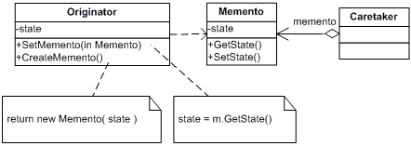
What we need for Memento Design Pattern
Originator
Memento
Caretaker

Slide 5
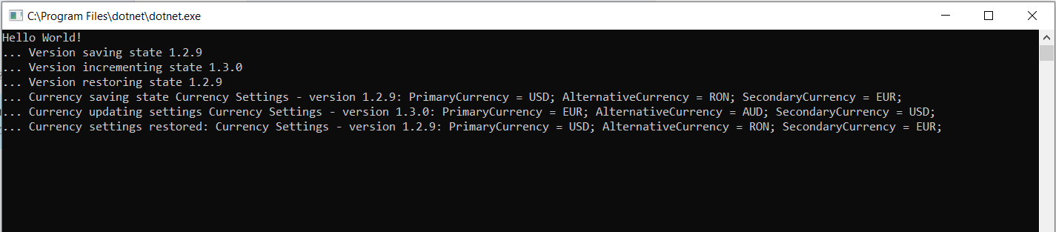
See Result

Slide 6
Advantages
Advantages
Preserves encapsulation.
An object internal state can be saved externally (to another object) without violating encapsulation (without making the internal data structures accessible).
Disadvantages
May introduce run-time costs.
Creating large numbers of mementos with large amounts of data may impact memory usage and system performance
Unless encapsulating and restoring Originator state is cheap, the pattern may not be appropriate.

Slide 7
Questions

Slide 8
References
GOF – Design Patterns - http://www.w3sdesign.com/GoF_Design_Patterns_Reference0100.pdf
Dotfactory - https://www.dofactory.com/net/design-patterns
Code example -https://gitlab.softvision.ro/enterprise.net/design-patterns/command

